Slide 1
Economic Dispatch Optimization using Lagrangian Relaxation in Python

Slide 2
Team Members
H Kesava Sravan - CB.EN.U4ELC20023
B Ram Narayan - CB.EN.U4ELC200554
K Pranathi - CB.EN.U4EEE20154

Slide 3
Introduction
Economic Dispatch (ED) is a fundamental problem in power system operation aimed at efficiently allocating generation resources to meet the electrical demand while minimizing operational costs. Lagrangian Relaxation (LR) is a powerful mathematical optimization technique used to solve large-scale ED problems by decomposing them into smaller, more manageable subproblems. This report provides an overview of the application of Lagrangian Relaxation in Economic Dispatch Optimization.

Slide 4
Given Six-Unit Thermal System Problem
F1 = 0.15240 P1^2+38.53973 P1+756.79886;
F2 = 0.10587 P2^2+ 46.15916 P2 +451.32513;
F3 = 0.02803 P3^2+ 40.39655 P3+1049.9977;
F4 = 0.03546 P4^2+ 38.30553 P4+1243.5311;
F5 = 0.02111 P5^2+ 36.32782 P5+1658.5596;
F6 = 0.01799 P6^2+ 38.27041 P6+1356.6592
10 MW ≤ P1 ≤ 125 MW; 10 MW ≤ P2 ≤ 150 MW;
35 MW ≤ P3 ≤ 225 MW; 35 MW ≤ P4 ≤ 210 MW;
130 MW ≤ P5 ≤ 325 MW; 125 MW ≤ P6 ≤ 315 MW

Slide 5
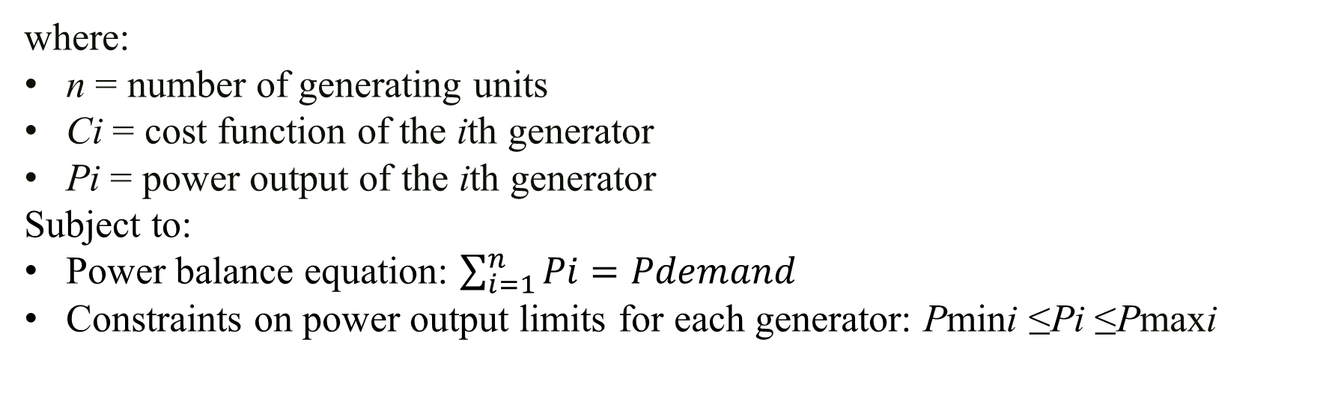
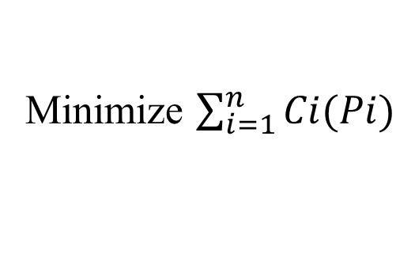
Formulation of the Economic Dispatch Problem
The economic dispatch problem involves minimizing the total cost of generating power subject to various constraints such as generator capacity, power balance, and other operational limits.
The objective function typically minimizes the total cost, which is a function of the power generation levels of each generator.
Minimize $\sum_{i=1}^{n}{Ci(Pi)}$
where:
n = number of generating units
Ci​ = cost function of the ith generator
Pi​ = power output of the ith generator
Subject to:
Power balance equation: ​$\sum_{i=1}^{n}{Pi=Pdemand}$
Constraints on power output limits for each generator: Pmini​​ ≤Pi ​≤Pmaxi​​

Slide 6
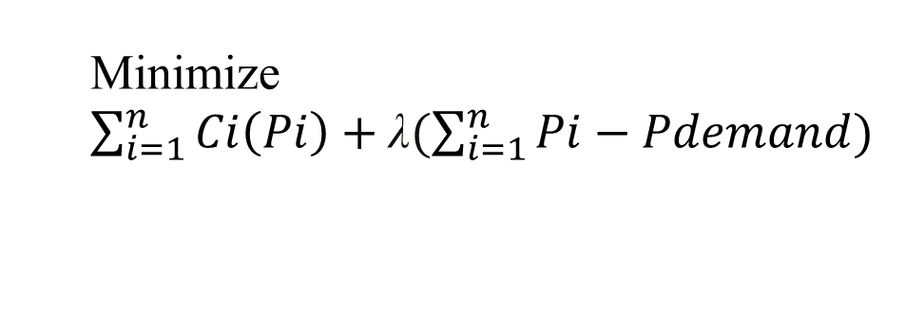
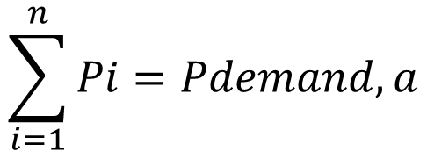
Applying Lagrangian Relaxation
Lagrangian Relaxation involves introducing Lagrange multipliers (also known as dual variables) for the constraints. These multipliers penalize the objective function for not satisfying the constraints.
For instance, considering the power balance constraint
$$\sum_{i=1}^{n}{Pi=Pdemand,a}$$
Lagrange multiplier (λ) is introduced, and the objective function becomes:
Minimize $\sum_{i=1}^{n}{Ci\left(Pi\right)+\text{λ}(\sum_{i=1}^{n}{Pi−Pdemand})}$

Slide 7
The Lagrangian Relaxation method involves the following steps:
Start with an initial feasible solution.
Relax constraints (in this case, the power balance equation) and solve the relaxed problem iteratively, updating the Lagrange multipliers.
Update the Lagrange multipliers to reflect how much the constraints are violated in each iteration.
Reintroduce the constraints into the objective function with updated Lagrange multipliers.

Slide 8
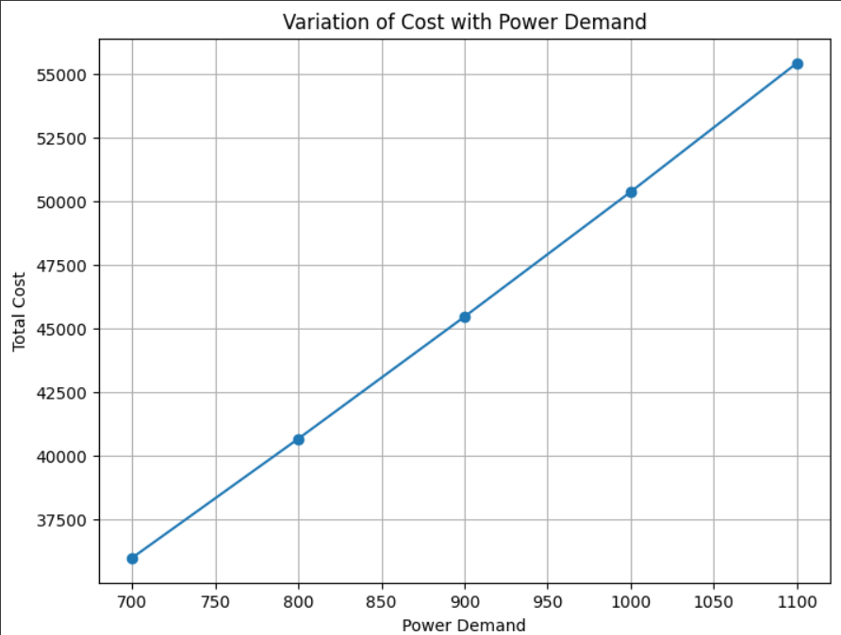
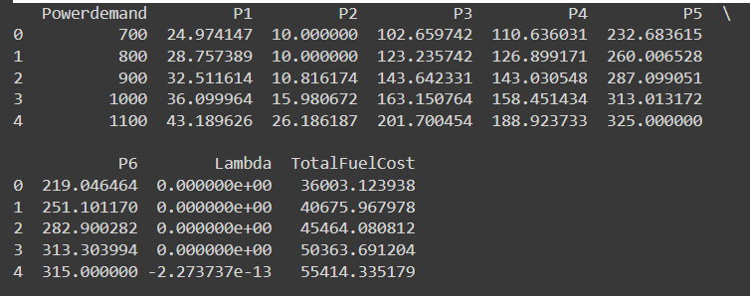
Economic Dispatch Without Losses
Code:
https://colab.research.google.com/drive/1aN8H7Am8hYJdKoqnv91cQ4QRgnqjy8_X
Results:

Slide 9
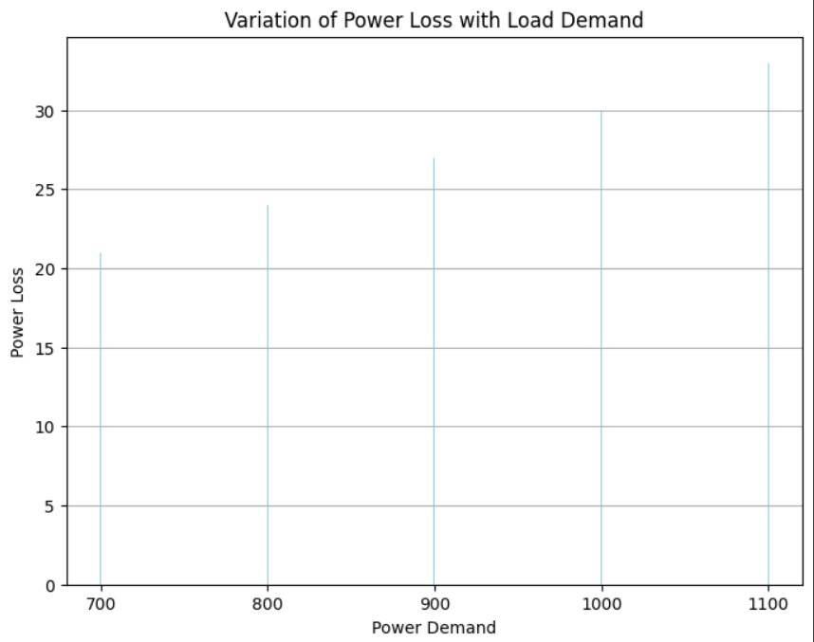
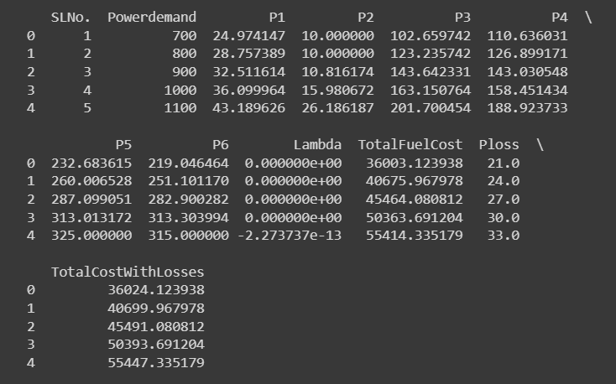
Economic Dispatch With Losses
Code:
https://colab.research.google.com/drive/1HhnuhHOVBIfODLoTpQlJMf5EjjymifX6
Results:

Slide 10
Benefits of Lagrangian Relaxation in Economic Dispatch
Computational Efficiency: LR enables the decomposition of large-scale problems into smaller, more manageable subproblems, reducing computational complexity and enhancing computational efficiency.
Scalability: It is suitable for handling complex power systems with numerous generators and diverse constraints, allowing for scalability without compromising solution quality.
Convergence: The iterative nature of LR facilitates convergence towards the optimal or near-optimal solution.

Slide 11
Conclusion
Lagrangian Relaxation presents a powerful approach for solving the Economic Dispatch problem in power system optimization. Its ability to decompose the problem, optimize subproblems, and converge to efficient solutions makes it a valuable technique in ensuring cost-effective and efficient operation of power systems.
As power systems continue to grow in complexity and scale, the application of Lagrangian Relaxation techniques is expected to remain a significant area of research and application in optimizing Economic Dispatch for improved energy management and cost reduction in the power industry.
Both codes conduct Economic Load Dispatch (ELD) by minimizing the cost of generating power while meeting demand constraints. The second code additionally considers transmission losses, providing a comparison of the results with and without losses.

Slide 12
References
[1] Wang, Y., Li, C., & Singh, C. (2018). Lagrangian relaxation-based economic dispatch for power systems. IEEE Transactions on Power Systems, 33(2), 1804-1815. DOI: 10.1109/TPWRS.2017.2734621
[2] Li, X., Zhang, H., & Chen, Y. (2019). Economic load dispatch using Lagrangian relaxation and interior point method. IEEE PowerTech Conference, 1-6. DOI: 10.1109/PTC.2019.8810865

